Slide 1

Code Refactoring and Bug Fixing

Slide 2
About me
NAME: RACHAKONDA ABHINAY
DEGREE : BACHELOR IN COMMERCE (computer Applications)
After my Graduation I found interest on IT domine . I start knowing about current treades and industries happenings ,so finally I applied for Data science course in Innomatics research labs.
I have hands-on experience in Data analysis, Power BI, and SQL to contribute to organizational success through proficient data cleaning, statistical analysis, and data visualization. I aim to provide actionable insights and recommendations that empower stakeholders to make informed, data-driven decisions, ultimately driving business growth and efficiency.
Gihub link : https://github.com/abhinay9505/Innomatics_Internship_projects
Linkedin link : https://www.linkedin.com/in/abhinay-rachakonda-068b58235/
TASK:
Refactor the existing codebase and ensure the proper functioning of the Note Taking Application. Document all identified bugs during the debugging process. Remember, the task is not about recreating the app from scratch. Your goal is to fix the already existing codebase and make the application work as intended.

Slide 3
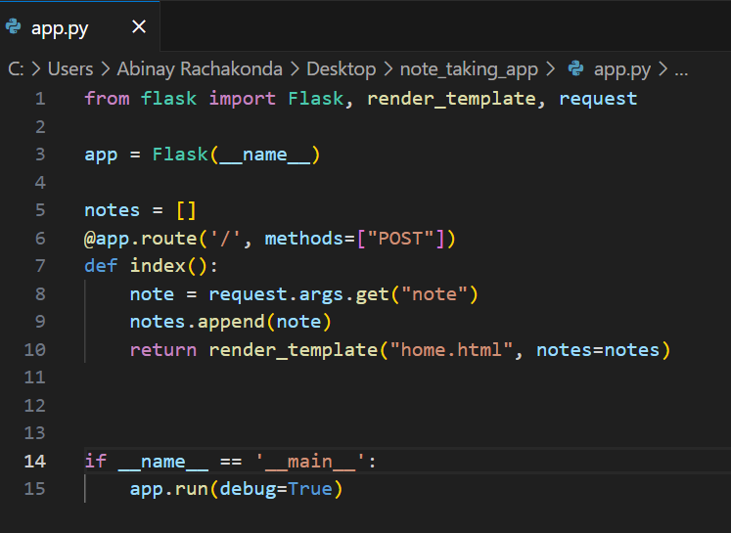
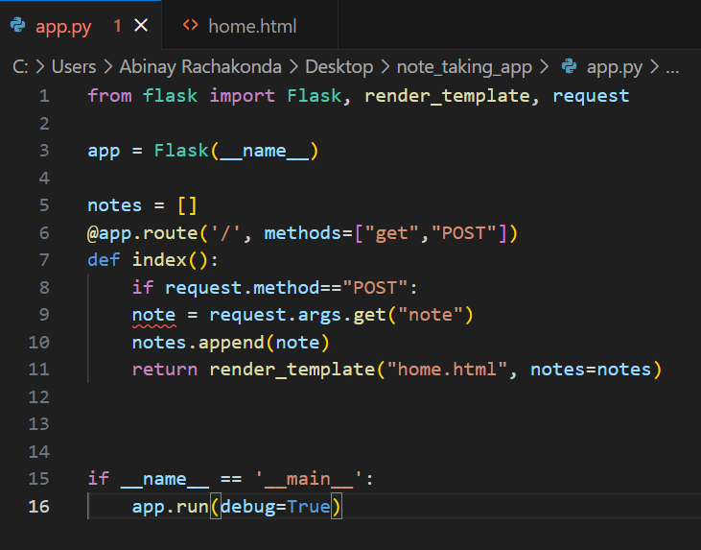
Before Bug Fixing After Bug Fixing
@app.route(‘/’,methods=[“GET”,”POST”])
1.Add "GET" along with "POST" in the method parameter of the route in the Python Flask application server
note=request.form.get(“note”)
This line of code retrieves the value of the form field named "note" submitted via POST request and assigns it to the variable note.

Slide 4
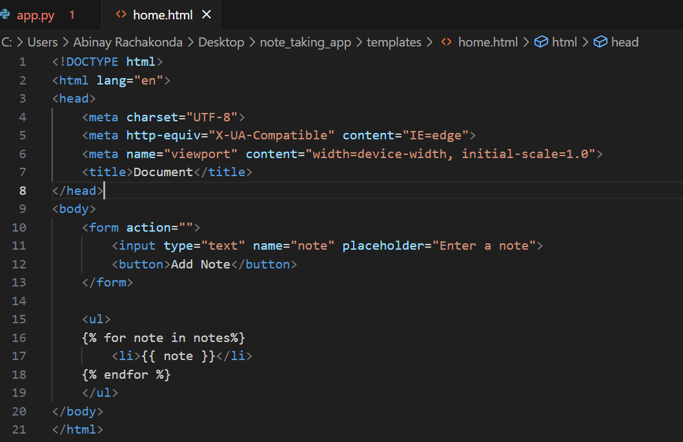
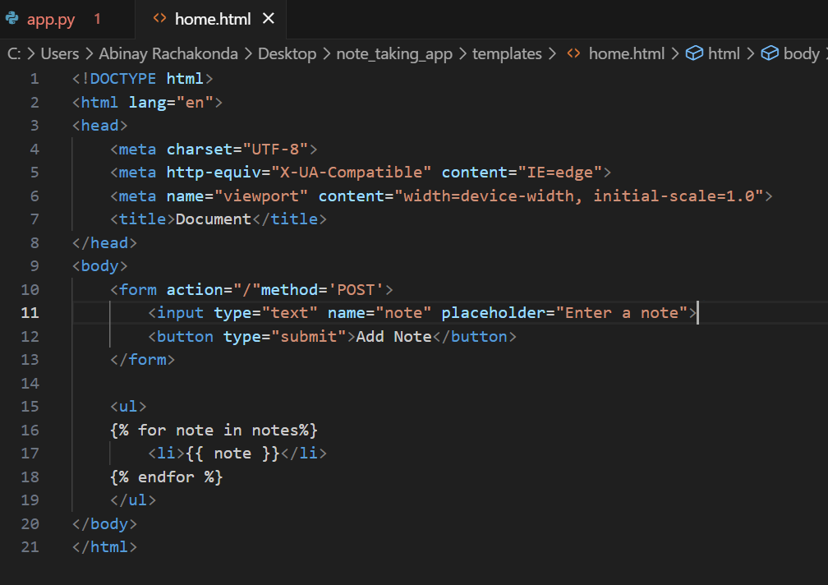
Before Bug Fixing After Bug Fixing
Method=“POST”
filling method="post" in the <form> tag indicates that the form data should be sent to the server using the HTTP POST method.
Type=“submit
Filling type="submit" in the <button> tag indicates that the button is a submit button within a form, and clicking it will trigger the submission of the form data to the server.

Slide 5
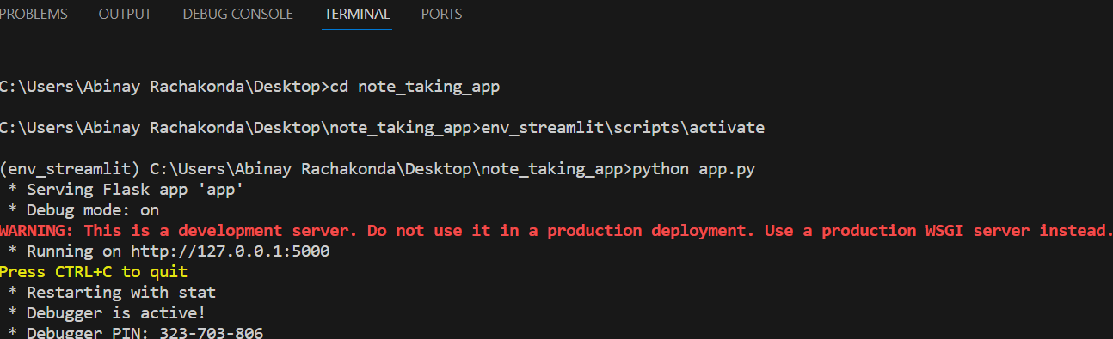
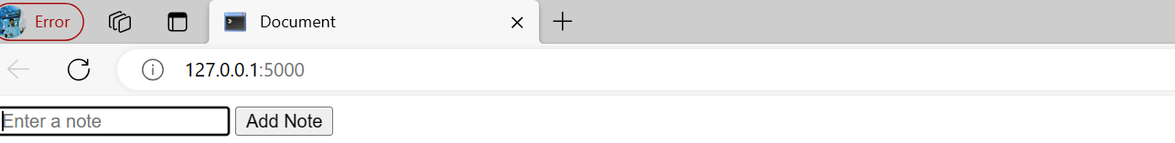
Final Output after Fixing The Bugs
TERMINAL:
OUTPUT:

Slide 6

THANK YOU

